Slide 1
ESP 106 Environmental Data Science
Lecture 2
More Advanced Indexing, Booleans, Reading and Writing Files

Slide 2
Upcoming calendar
No class and lab next Monday (16-Jan MLK day)
Office hour on Thursday 2-4pm at Veihmeyer Hall 136
Lab 1 due 15-Jan

Slide 3

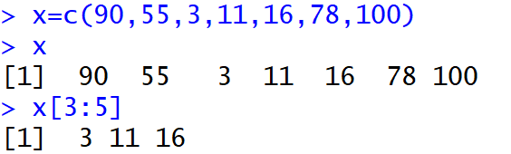
Some More Advanced Indexing Tips - Sequences
Use : to create a sequence of integers between two values
You can use this to quickly access a set of adjacent values in a vector or matrix
The 3rd, 4th and 5th element of the vector x

Slide 4
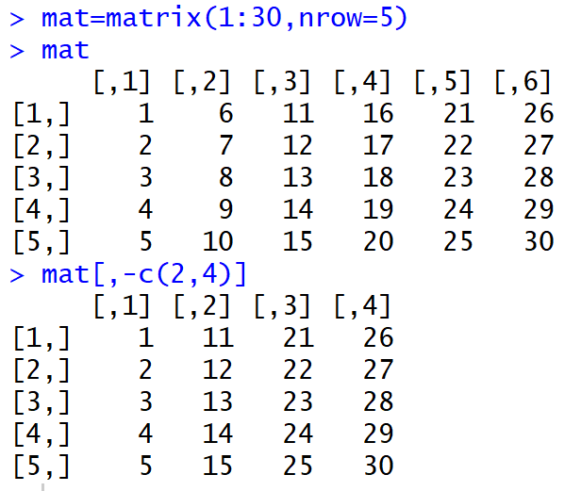
Some More Advanced Indexing Tips – Negative Indexes
A negative sign in an index indicates you want all elements of the vector / matrix except the ones indicated
Create a matrix with the values between 1 and 30 in 5 rows
All columns of the matrix except 2 and 4

Slide 5
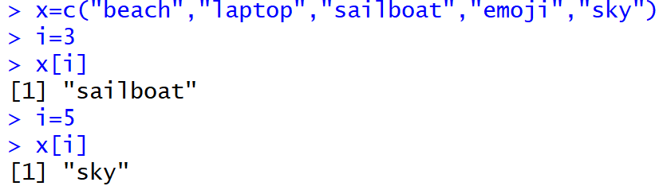
Some More Advanced Indexing Tips – Using a Variable for Indexing
Use a variable to index into a vector, matrix, or list – very important for for loops (next week)
Return the i’th value of x
The value of i has changed (from 3 to 5) so the i’th value of x also changes

Slide 6
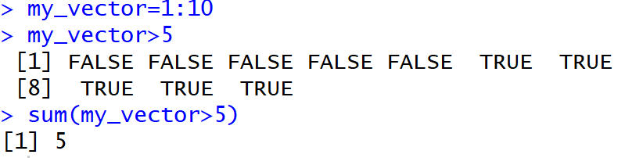
Some More Advanced Indexing Tips – Boolean / Logical Indexing
An important additional data-type: Boolean
TRUE / FALSE (also T / F in R)
Use > (greater than) < (less than) and == (is equal to) to query vectors / matrices (also >= and <=)
Are the elements of my_vec greater than five?
Vector of logical (Boolean) values indicating whether each element is greater than 5
Summing a logical vector gives the number of true values in the vector (i.e. TRUE=1 and FALSE=0)

Slide 7
Some More Advanced Indexing Tips – Boolean / Logical Indexing
Use conditional statements to index into vectors / matrices and find elements that meet certain conditions
which() can be a useful function here – returns index values for which the condition is true

Slide 8
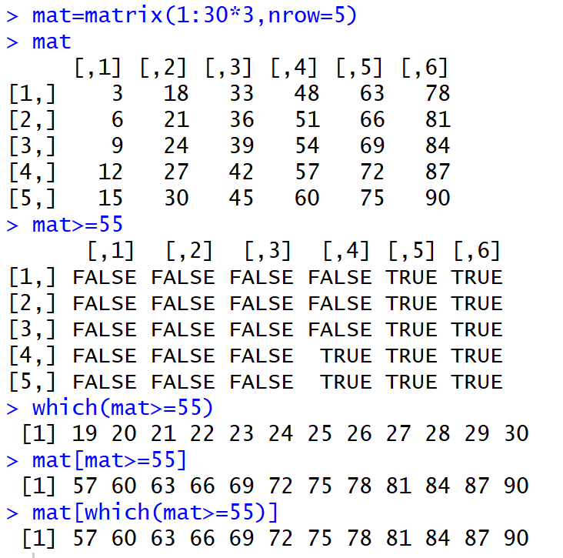
Create a matrix containing the first 30 multiples of 3
Are the values greater or equal to 55?
Index values for which the condition is true
Two ways of returning the values of mat for which the condition is true
NOTE: uses one value to index matrix instead of two

Slide 9
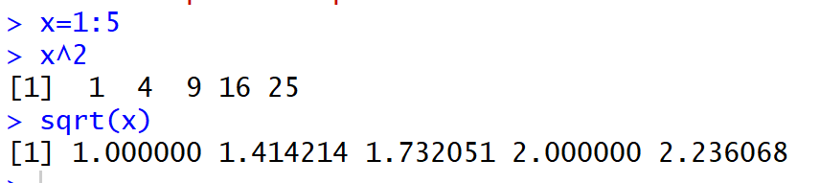
Vectorized Functions in R
R has a special ability to apply functions over vectors – if you pass a vector to a function, by default R will apply the function to each element in a vector
E.g.

Slide 10
Directories, Reading and Writing Files

Slide 11
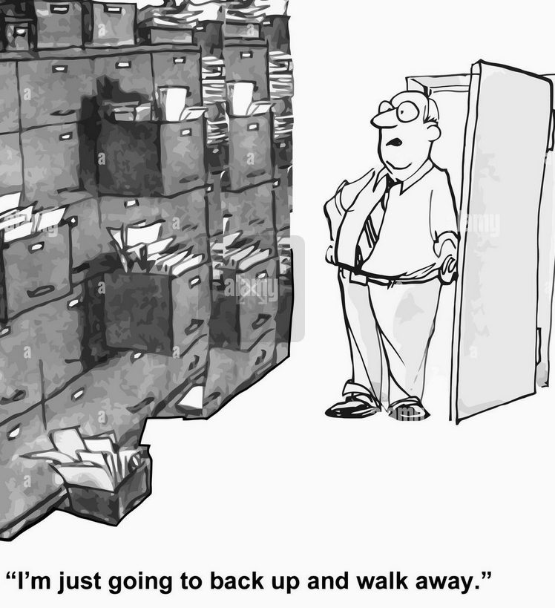
Get Familiar With Navigating Files in Your Computer!
Using R is much much easier if you keep your files well organized on your computer
You need to tell R where to find files you want to use and where to save data you generate
Keeping things well organized will make your life much easier

Slide 12
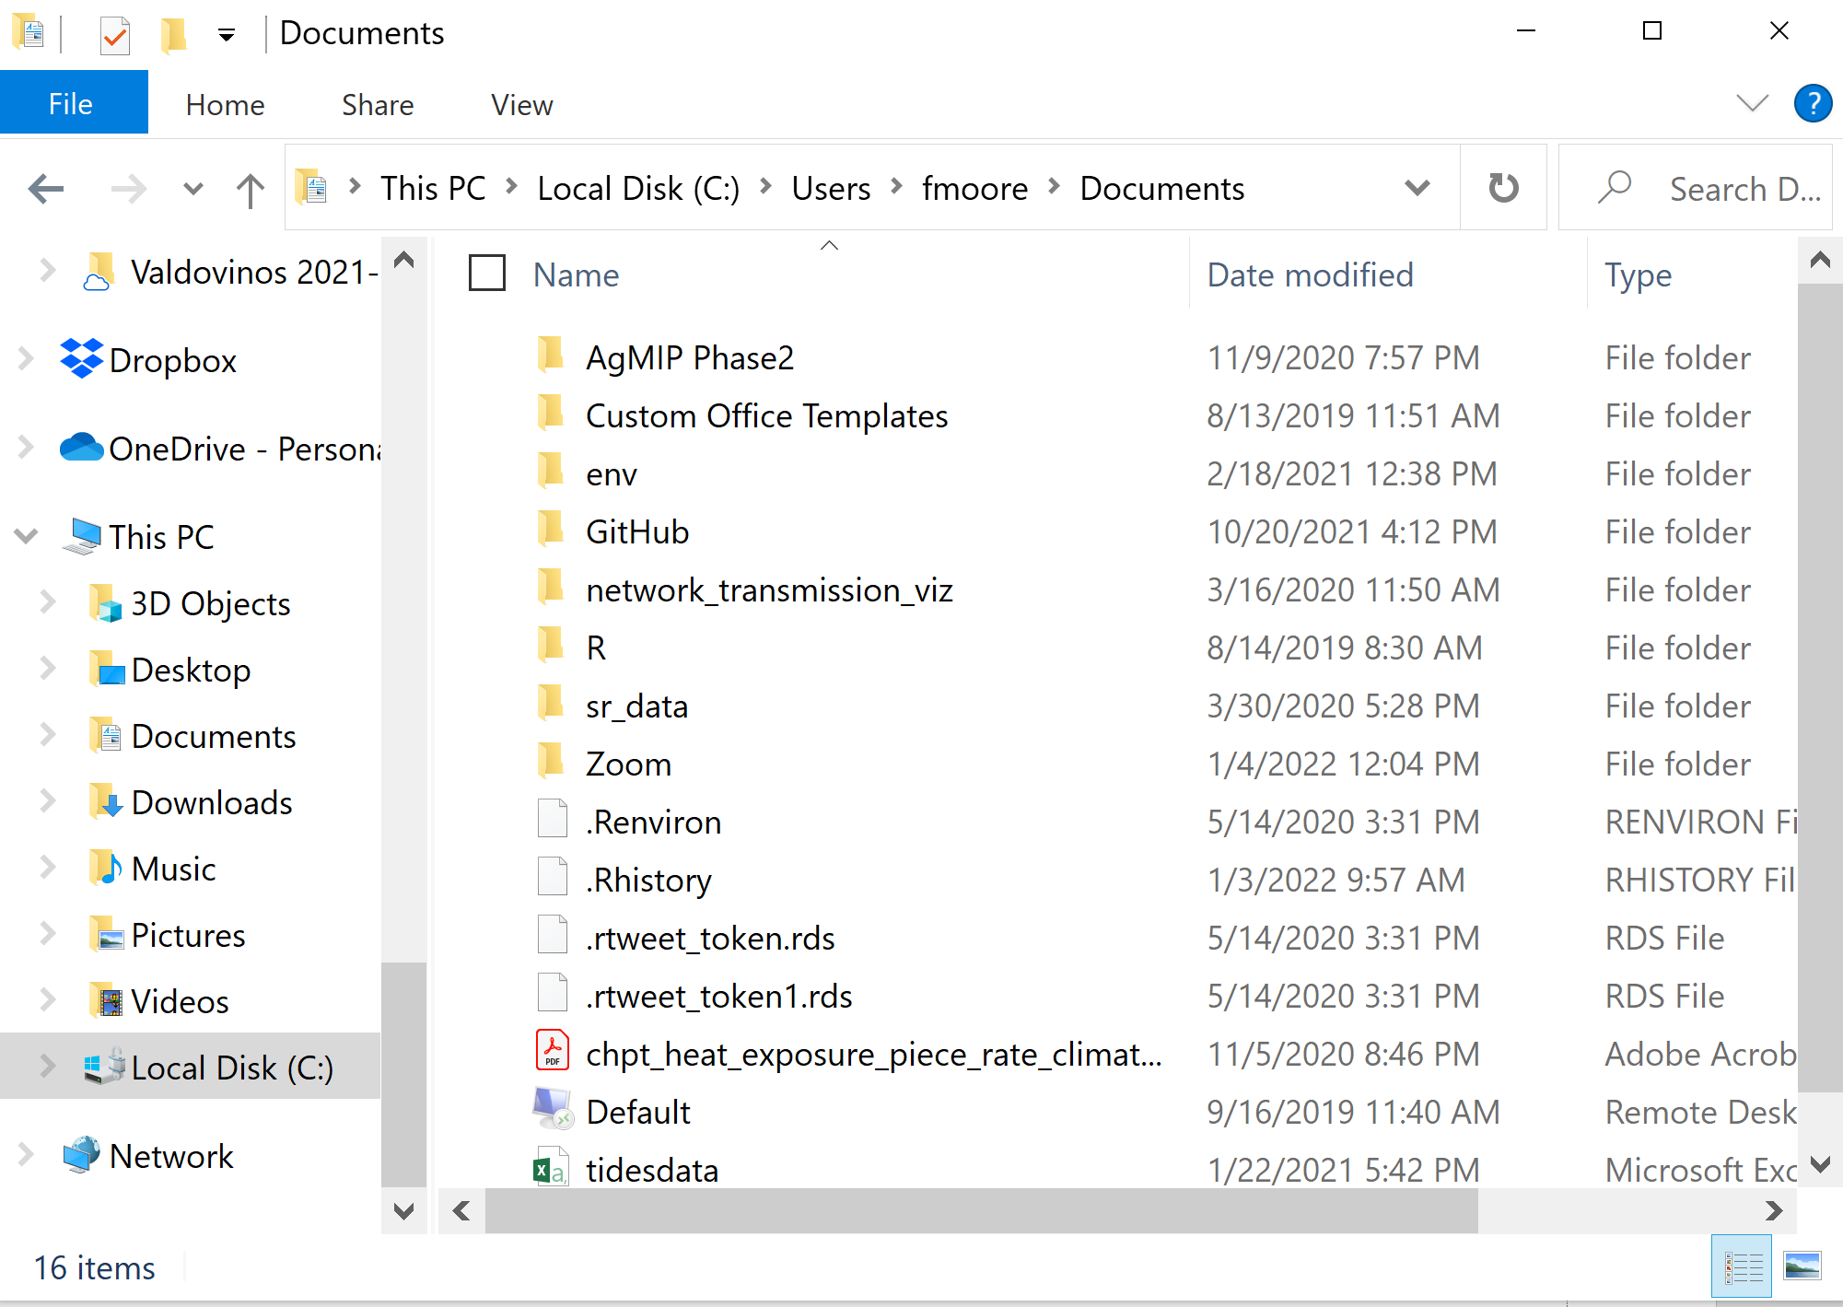
Drives and Directories
Information on computers is divided into drives indicated by a capital letter
Most computers (?) use the C drive as default
Within drives, data is organized into a series of nested directories (folders)
Every file on the computer has a unique path (address) given by the drive and the set of folders you need to get to it
C:/Users/fmoore/Documents

Slide 13
Paths
A path is the “address” of a file on your computer
The full path starts with the drive name (usually C) followed by a colon and forward slash
Then a series of folders separated by forward slash
Add the file name to the path to uniquely identify a particular file
For example:
C:/Users/fmoore/Box/Teaching/ESP 106/Lab Assignments/ESP106_Lab1.R
Indicates file type – e.g. .R indicates an R script file
Path
Drive
Set of Nested Directories
File Name

Slide 14
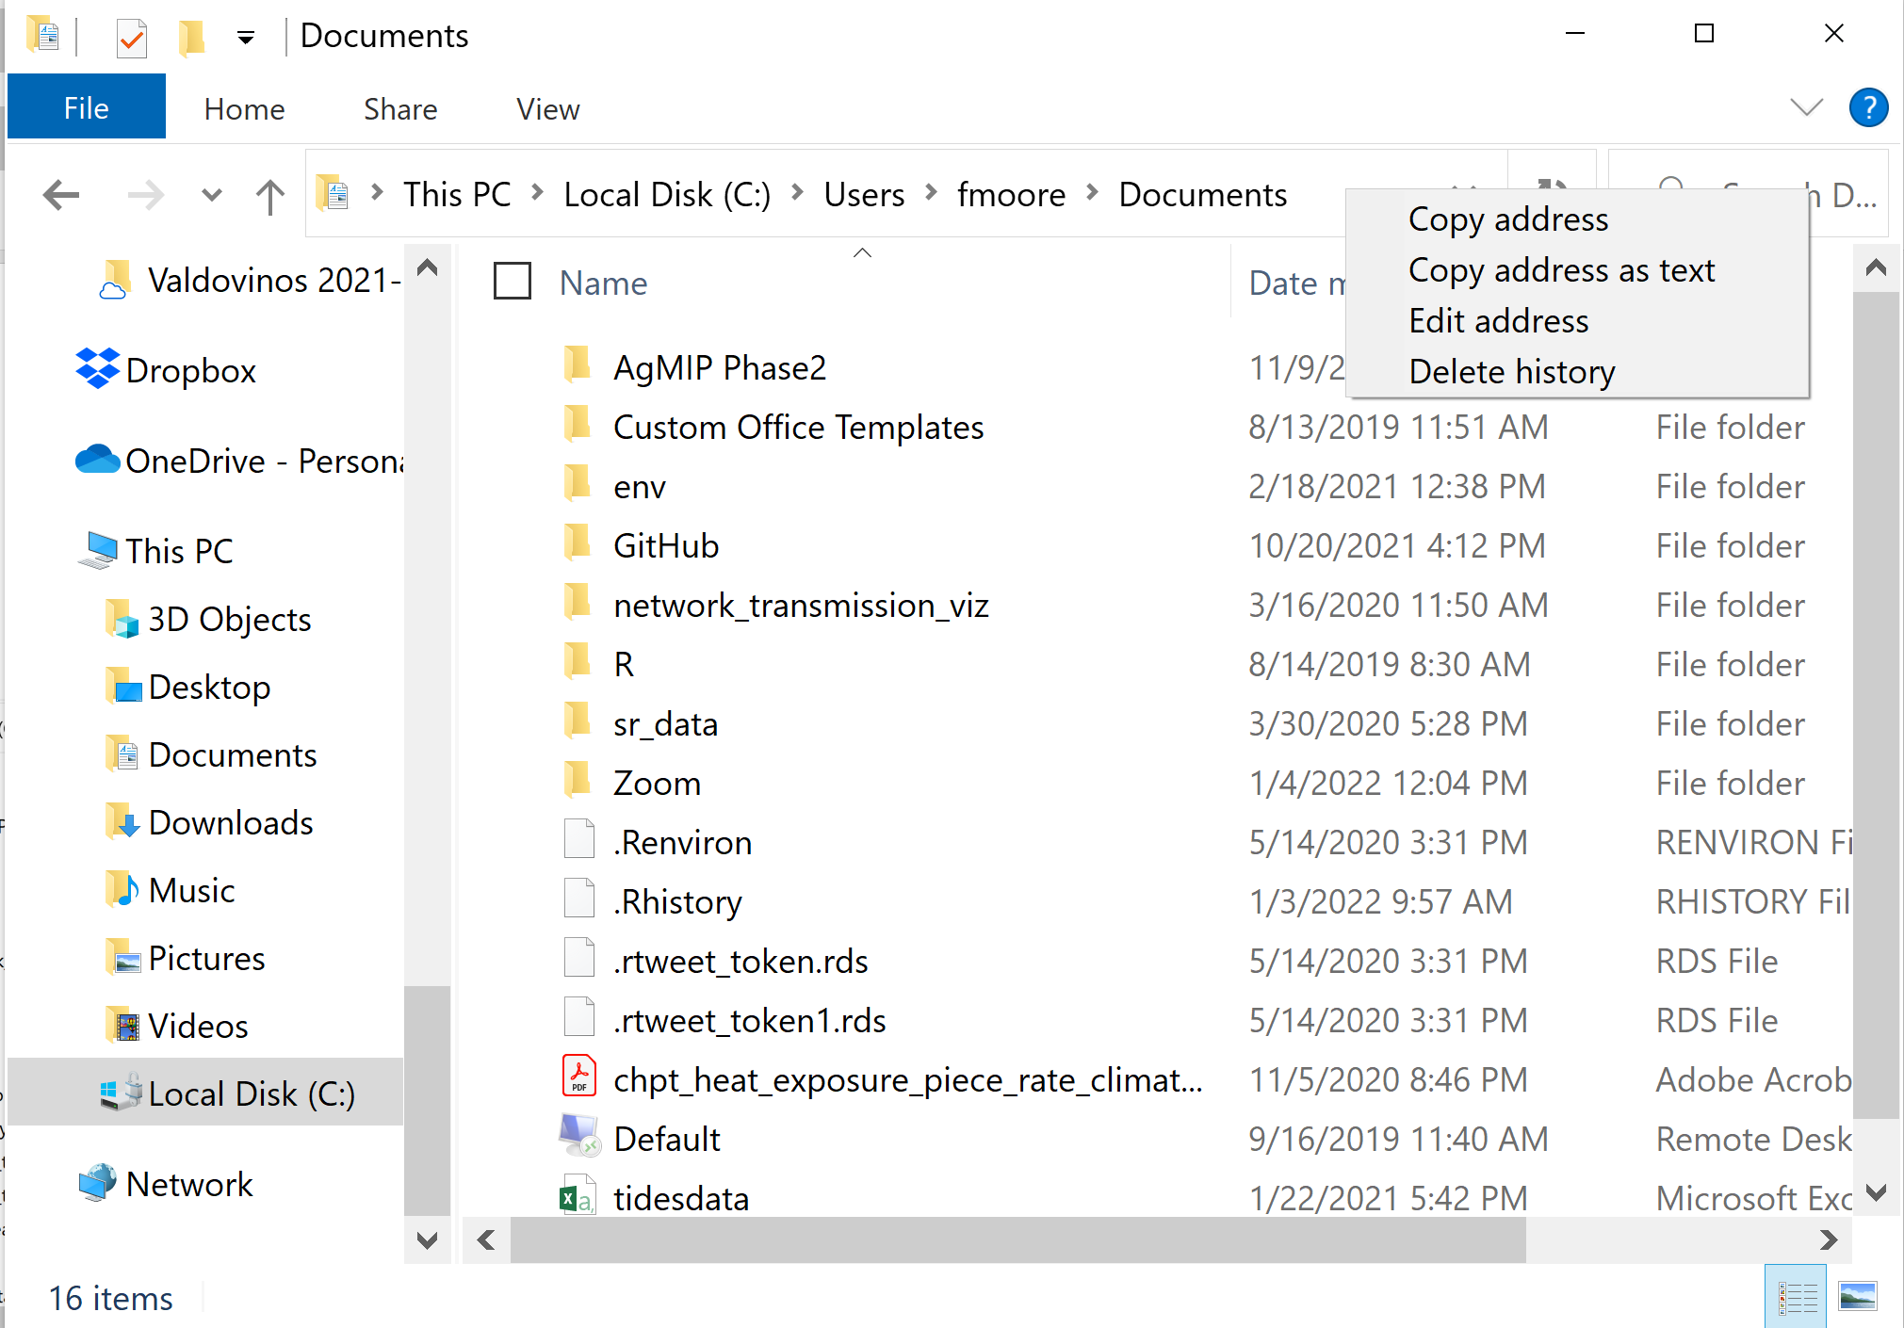
Paths
On Windows computers, use Windows Explorer to navigate through different drives / directories
Right click in the address bar and chose “Copy address as text” to get the path to the directory you are currently in
(Note: Windows separates directories using backslashes – need to change to forward slashes to use in R)
Apples have something similar (Finder?)

Slide 15
Reading Data in and Out of R
Different data types need to be read into R using particular functions, which specify how R should interpret the data in the file
For the moment we will focus on simple csv (comma separated value) data, which is a common way of storing tables of data
Variable name you want the data to have in R
Path and filename of the data file you want to read in
dataname=read.csv(“filepath/filename.csv”)
Data in R that you want to write to a csv file (data frame or matrix usually)
Path and name of the file where you want the data to go
write.csv(dataname,“filepath/filename.csv”)
Save lots of objects into a R data (Rdat) file
save(a,b,d,e,“filepath/filename.Rdat”)

Slide 16
Working Directories
It can be really annoying to keep writing out long path names to read and write files in your code
A working directory is a path that R will start with by default that you don’t need to type every time – only need the paths to the file relative to the working directory
Default working directory will be something like “Documents” on a Windows computer – reset it to something more useful at the top of your script file

Slide 17
Useful Functions
getwd()
setwd(“pathname”)
list.files(“pathname”)
Print the current working directory
Set the working directory to a different directory given by pathname.
If you are setting the working directory in the code, do it right at the top so it is obvious to other people that might want to use your code
Print the names of files and directories in the directory at pathname. If no pathname given then prints files / directories in the working directory

Slide 18
Organize Your Directories!
Being disciplined and organized about file organization will make your coding life much much easier
Some tips:
Create a new directory for each coding project (e.g each “ESP106_Lab1”)
Keep all material related to that project (data, script files etc) in that folder.
Set this as the working directory in all your code
Within this directory, have separate folders to keep input data, script files, code output (e.g. processed data, figures)

